Slide 1
Predicting Risk of Stroke
Alexandra de Roos, George Kalad, Ryan Williams

Slide 2

Project Overview
Context of Stroke costs in the US
Data pre-processing
Machine Learning
Logistic Regression & Neural Network
Visualizations

Slide 3

Project Context
A stroke occurs every 40 seconds
Someone dies of a stroke every 3 minutes 14 seconds
795,000 people died of stroke in US in 2021
610,000 of those were first time strokes
Between 2018-2019 stroke-related costs neared $ 56.5B

Slide 4

Data Pre-Processing
Features vs. target variable
Ex: marital status, age, work type, BMI
Cleaning Process

Slide 5

Machine Learning
Logistic Regression
Neural Networks
Binning for job type

Slide 6
Visualizations

Slide 7
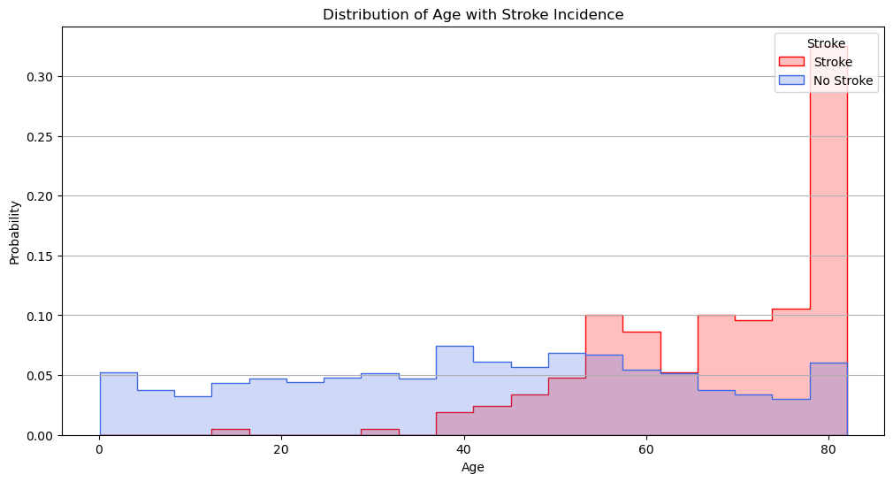
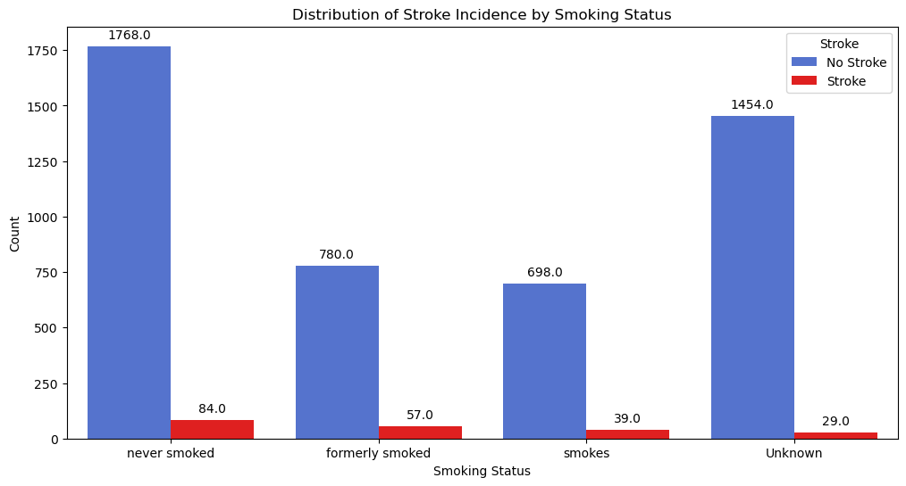
Age
Smoking

Slide 8
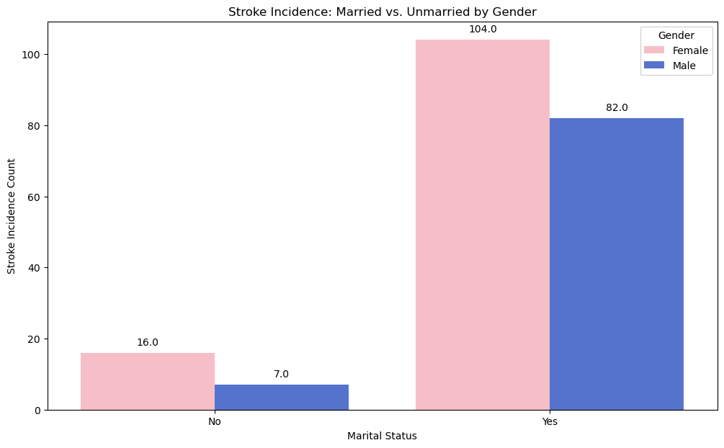
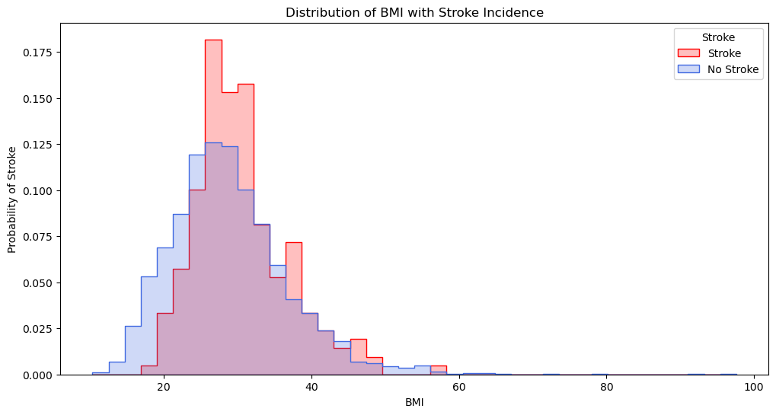
Marriage
BMI

Slide 9
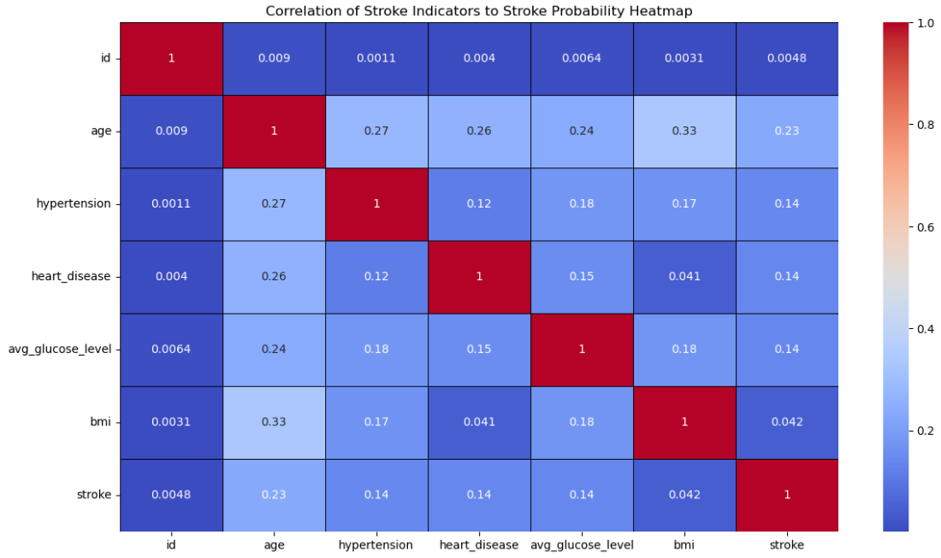

Slide 10

Next Steps
More Data
New features
Different Models

Slide 11
Questions?

Slide 12
Sources
https://www.google.com/url?sa=i&url=https%3A%2F%2Fwww.datasciencecentral.com%2Fstroke-prediction-using-data-analytics-and-machine-learning%2F&psig=AOvVaw0mK62uAzkjnVvefr36V45v&ust=1696026936397000&source=images&cd=vfe&opi=89978449&ved=0CBAQjRxqFwoTCJijruquzoEDFQAAAAAdAAAAABAE
https://www.cdc.gov/stroke/facts.htm
https://www.google.com/url?sa=i&url=https%3A%2F%2Fwww.istockphoto.com%2Fillustrations%2Fstroke-patient&psig=AOvVaw1OAvR10jZuMzrjKxs_1J0j&ust=1696027657675000&source=images&cd=vfe&opi=89978449&ved=0CBAQjRxqFwoTCNCfl8KxzoEDFQAAAAAdAAAAABAE
https://www.google.com/url?sa=i&url=https%3A%2F%2Fwww.scalablepath.com%2Fdata-science%2Fdata-preprocessing-phase&psig=AOvVaw2WVUnK0y9ZTk0qrxwhGJW4&ust=1696029576142000&source=images&cd=vfe&opi=89978449&ved=0CBAQjRxqFwoTCLjyg9W4zoEDFQAAAAAdAAAAABAE
https://www.vizrt.com/wp-content/uploads/ai-ml-new20article-vizrt-hdr-img-1920x1080-1.png
https://media.istockphoto.com/id/1401095135/vector/hand-drawn-doodle-foot-print-with-choice-direction-arrow-icon-illustration.jpg?s=612x612&w=0&k=20&c=9jWMedscYYsJRYXnUzMoQ4WEmIHeI-K9zHlKGnd3njk=

